Slide 1
Data Types and Collection
Chapter -1

Slide 2
Overview
Types of data
Type of an attribute
Different types of Attributes
Types of data sets
General characteristics of a dataset
Handling non record data
Data quality
Measurements and data collection issues
Precision, bias and Accuracy

Slide 3
What is Data set?
Collection of data objects and their attributes
An attribute is a property or characteristic of an object
Examples: eye color of a person, temperature, etc.
Attribute is also known as variable, field, characteristic, dimension, or feature
A collection of attributes describe an object
Object is also known as record, point, vector, pattern, case, sample, observation, entity, or instance
Attributes
Objects

Slide 4
Each row corresponds to a student and each column is an attribute that describes some aspect of a student such as grade point average (GPA) or identification number

Slide 5
Record based data sets are common
Other types of data sets: Flat files or relational database systems

Slide 6
What is an attribute?
An attribute is a property or characteristic of an object that may vary either from one object to another or from time to time
Eg: Eye color
Temperature of an object varies over time
Eye color: brown, black,blue,green, hazel etc. (small no of attributes)
Temperature is a numeric attribute: unlimited no of values

Slide 7
Measurement scale
Is a rule that associates a numerical or symbolic value with an attribute of an object
Application of measurement scale to associate a value with a particular attribute of a specific object
Eg: weight measurement ,classify someone as male or female, count no of chairs
Physcial value of an attribute is mapped to numerical value or symbolic value.

Slide 8
Type of an Attribute
Two attributes associated with an Employee are : Employee Age (in years) and ID
Both attributes are represented as integers
Average employee age vs average employee ID
Which one makes sense?

Slide 9
ID must be distinct
Valid operation for employee ID is to test whether they are equal

Slide 10
Attribute Values
Attribute values are numbers or symbols assigned to an attribute for a particular object
Distinction between attributes and attribute values
Same attribute can be mapped to different attribute values
Example: height can be measured in feet or meters
Different attributes can be mapped to the same set of values
Example: Attribute values for ID and age are integers
But properties of attribute values can be different

Slide 11
Types of Attributes
There are different types of attributes
Nominal
Examples: ID numbers, eye color, zip codes
Ordinal
Examples: rankings (e.g., taste of potato chips on a scale from 1-10), grades, height {tall, medium, short}
Interval
Examples: calendar dates, temperatures in Celsius or Fahrenheit.
Ratio
Examples: temperature in Kelvin, length, counts

Slide 12
Attribute types
Nominal and Ordinal attributes are collectively referred to as categorical or qualitative attributes
Interval and ratio are collectively referred to as quantitative or numeric attributes

Slide 13
Qualitative attributes such as employee ID lack most of the properties of numbers even if they are represented by numbers
Here integers should be treated as symbols.

Slide 14
Quantitative attributes are represented by numbers and have the most properties of numbers.
The quantitative attributes can be integer values or continuous

Slide 15
Properties of Attribute Values
The type of an attribute depends on which of the following properties/operations it possesses:
Distinctness: = ≠
Order: < >
Differences are + - meaningful :
Ratios are * / meaningful
Nominal attribute: distinctness
Ordinal attribute: distinctness & order
Interval attribute: distinctness, order & meaningful differences
Ratio attribute: all 4 properties/operations

Slide 17
Describing attributes by number of values
An independent way of distinguishing between attributes is by the number of values they take.
Discrete: attribute has a finite or countable infinite set of values. Such attributes can be categorical such as zip codes or ID numbers or numeric such as counts.
Binary attributes: special case of discrete attributes and takes only two values (Yes/no, true/false, female/male or 0/1)

Slide 19
Binary attributes are often represented as Boolean variables or as integer variables that can take value 0 or 1
Continuous : attributes whose values are real numbers

Slide 20
Discrete and Continuous Attributes
Discrete Attribute
Has only a finite or countably infinite set of values
Examples: zip codes, counts, or the set of words in a collection of documents
Often represented as integer variables.
Note: binary attributes are a special case of discrete attributes
Continuous Attribute
Has real numbers as attribute values
Examples: temperature, height, or weight.
Practically, real values can only be measured and represented using a finite number of digits.
Continuous attributes are typically represented as floating-point variables.

Slide 21
Nominal and Ordinal attributes are binary or discrete
Interval and ratio are continuous.

Slide 22
Asymmetric Attributes
Only presence (a non-zero attribute value) is regarded as important
Words present in documents
Items present in customer transactions
Examples: each object is a student and each attribute records whether or not a student took a particular course
(1- student took the course, otherwise – 0)
Asymmetric attributes: Binary attributes where only non-zero values are important

Slide 23
Attribute Types
The types of operations you choose should be “meaningful” for the type of data you have
Distinctness, order, meaningful intervals, and meaningful ratios are only four properties of data
The data type you see – often numbers or strings – may not capture all the properties or may suggest properties that are not there
Analysis may depend on these other properties of the data
Many statistical analyses depend only on the distribution

Slide 24
Types of data sets
Record
Data Matrix
Document Data
Transaction Data
Graph
World Wide Web
Molecular Structures
Ordered
Spatial Data
Temporal Data
Sequential Data
Genetic Sequence Data

Slide 25
Important Characteristics of Data
Dimensionality:
Sparsity
Resolution
Size
Type of analysis may depend on size of data

Slide 26
General characteristics of Data sets
Dimensionality: The number of attributes that the objects in a data set possess
High dimensional data brings a number of challenges
curse of dimensionality
First step in preprocessing the data (dimensionality reduction)
Sparsity
Only presence counts (non zero are stored)
Reduces computation time and storage
Data mining algorithms work well only for sparse data

Slide 27
General characteristics of Data sets
Resolution
Obtain data at different levels of resolution and data properties are different at different resolutions
Eg. Earth surface at a resolution of few meters and at resolution of tens of kilometers
Patterns in data also depend on resolution. If the resolution is too fine (pattern may not be visible or buried)
Resolution too coarse pattern may disappear.
Eg: Variations in atmospheric pressure on a scale of hours reflect the movement of storms
On a scale of months such phenomena are not detectable

Slide 28
Record Data
Data that consists of a collection of records, each of which consists of a fixed set of attributes

Slide 29
Transaction Data
A special type of record data, where
Each record (transaction) involves a set of items.
For example, consider a grocery store. The set of products purchased by a customer during one shopping trip constitute a transaction, while the individual products that were purchased are the items.

Slide 30
Transaction data example

Slide 31
Data Matrix
If data objects have the same fixed set of numeric attributes, then the data objects can be thought of as points in a multi-dimensional space, where each dimension represents a distinct attribute
Such data set can be represented by an m by n matrix, where there are m rows, one for each object, and n columns, one for each attribute

Slide 32
Sparse data matrix
Special case of data matrix
Only non-zero values are important
Examples: Transaction data and document data

Slide 33
Document Data
Each document becomes a ‘term’ vector
Each term is a component (attribute) of the vector
The value of each component is the number of times the corresponding term occurs in the document.

Slide 34
Example of document data

Slide 35
Graph data
Representation of data:
The graph captures relationships among data objects and
The data objects themselves are represented as graphs

Slide 36
Data with relationship among objects

Slide 37
Data with relationship among objects
Graph: nodes and links
Data objects are mapped to nodes while the relationships among objects are captured by the links
Eg: World wide web(WWW) which contain both text and links to other pages
To process search queries: link(links to and from each page) information is exploited

Slide 38
Graph Data
Examples: Generic graph, a molecule,
Benzene Molecule: C6H6

Slide 39
Data with objects that are graphs
Graphs: If objects have structure, or (objects contains sub objects that have relationships)
Example: structure of chemical compounds (nodes- atoms and links between nodes are chemical compounds), Benzene (ball and stick diagram)
Graph representation helps to identify which substructures occur frequently in a set of compounds, also indicate the presence or absence of certain chemical properties such as melting point or heat of formation

Slide 40
Ordered data
For some types of data, the attributes have relationships that involve order in time or space.

Slide 41
Sequential data
Sequential or temporal data: extension of record data
Each record has a time associated with it.(purchase history of a customer with a listing of items purchased at different times)
Eg: Retail Transaction data: time at which the transaction took place.
Analysis it to find “candy sales peak before Halloween”

Slide 42
Sequential transaction data
Time | Customer | Items Purchased
t1 | C1 | A,B
t2 | C3 | A,C
t2 | C1 | C,D
t3 | C2 | A,D
t4 | C2 | E
t5 | C1 | A,E
Customer | Time and Items Purchased
c1 | (t1: A,B) (t2:C,D),(t5:A,E)
c2 | (t3: A,D) (t4: E)
c3 | (t2: A,C)

Slide 43
Five different times: t1,t2,t3,t4,t5
3 different customers: C1,C2,C3
5 different items: A,B,C,D,E
Table1: rows correspond to the items purchased at a particular time by each customer (At time t3: customer c2 purchases items A and D)

Slide 44
Sequence Data
Sequence Data: consists of a data set that is a sequence of individual entities such as sequence of words or letters
Similar to sequential data : but no timestamps
Eg: Genetic information of plants and animals
Genes: genetic information is represented in the form of sequences of nucleotides

Slide 45
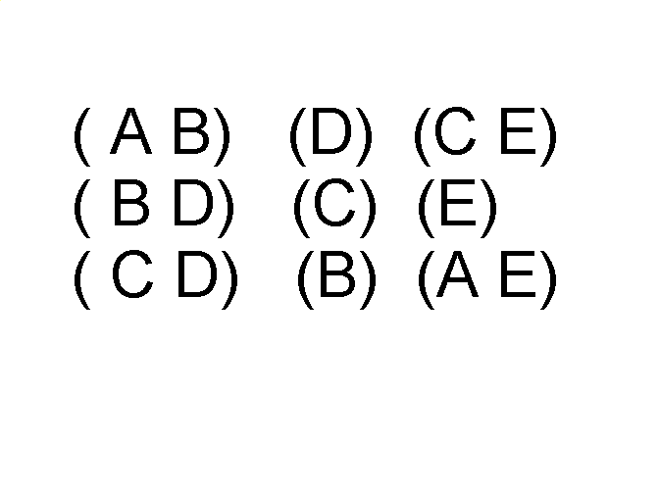
Sequence Data
Sequences of transactions
Items/Events
An element of the sequence

Slide 46
Sequence data example
Genomic sequence data

Slide 47
Sequence data
Human genetic code expressed using 4 nucleotides from which a DNA is constructed
4: A,T,G AND C

Slide 48
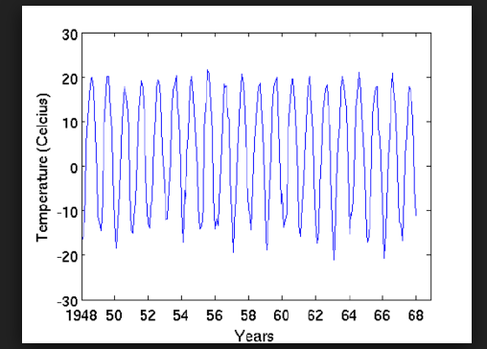
Time series data

Slide 49
Time series data
Time series data is a special type of sequence data
Each record is a time series ( series of measurements taken over time )
Eg: financial data (objects that ate time series of the daily prices of various stocks), average monthly temperature for Minneapolis
Temporal auto-correlation: 2 measurements are close in time then the values of measurements are often similar.

Slide 50
Ordered Data
Spatio-Temporal Data
Average Monthly Temperature of land and ocean

Slide 51
Spatial data
Spatial data: Some objects have spatial attributes such as position or area
Example : weather data(temperature, pressure, precipitation) collected for variety of geographical locations.
Spatial auto-correlation: objects that are close to each other they tend to have similar temperature values (temperature and rainfall)

Slide 52
Spatial data
Examples of spatial data: science and Engineering data sets
Earth science data set: records the temperature or pressure measured at points (grid cells) on latitude-longitude spherical grids of a various resolutions
Simulation of the flow of gas, the speed of direction of flow( can be recorded for each grid point )

Slide 53
Data Quality …
What kinds of data quality problems?
How can we detect problems with the data?
What can we do about these problems?
Examples of data quality problems:
Noise and outliers
Missing values
Duplicate data
Wrong data

Slide 54
Handling non record data
Data mining algorithms are designed for handling record data
Example of record data: transaction data and data matrices
Examples of non record data: graph based and spatial data

Slide 55
Handling non-record data
Same record oriented techniques can be applied to non record data
Extract features from data objects
By using these features create a record data for each data object
Example: chemical structure data , spatio temporal data

Slide 56
Handling non-record data
Each compound can be created as a record with binary attributes that indicate whether a compound contains a specific substructure
This representation is similar to transaction data set where the transactions are the compounds and the items are the substructures

Slide 57
Handling non-record data
Consider spatio- temporal data consisting of a time series from each point on a spatial grid.
This data can be stored as a data matrix where each row consists of a location and each column represents a particular point in time.

Slide 58
Data Quality
Detection and correction of data quality
Problems
Use of algorithms that can tolerate poor data quality
Data cleaning: the step in detection and correction

Slide 59
Measurement and Data Collection Issues
problems: human error, limitations of measuring devices, or flaws in the data collection
eg. values or even entire data objects are missing, duplicate data objects
multiple data objects that correspond to a single real object eg. two different records for a person who lived at two different addresses.
inconsistencies in data eg. a person has a height of 2 meters but weighs only 2 kilograms

Slide 60
Measurement and Data Collection Errors
Measurement error: refers to any problem resulting from the measurement process
problem: value recorded deviates from the true value
continuous attributes: numerical difference of the measured and true value is called as error
data collection error: refers to errors such as omitting data objects or attribute values or inappropriately including a data object
eg. study of animals of certain species might include animals of related species that are similar
key board errors when data is entered manually

Slide 61
Noise and artifacts
Noise is the random component of a measurement error, it may involve the distortion of a value or the addition of spurious objects
before noise and after noise
noise term is often used in connection with data that has a spatial or temporal component
image and signal processing techniques are applied
artifact: distortion of data eg. such as a streak in the same place on a set of photographs

Slide 62
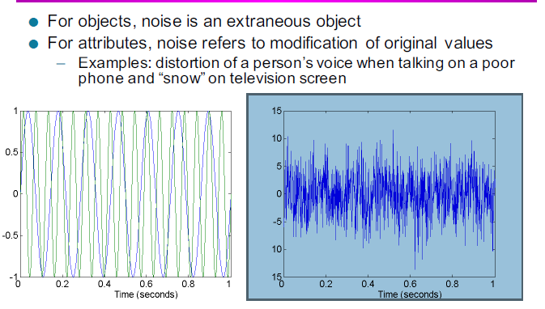

Slide 63
Definitions
Precision : The closeness of repeated measurements (of the same quantity )to one another
measured by standard deviation
Bias: A systematic variation of measurements from the quantity being measured
measured by taking the mean of the set of values
Accuracy: The closeness of measurements to the true value of the quantity being measured

Slide 64
Accuracy depends on both precision and bias. You don't have any specific formula . Important aspect in accuracy is use of significant digits. Generally for accuracy it is better to use as many digits as possible to represent the result
eg. length of an object is measured with a meter stick whose smallest markings are millimeters (record the length to the nearest millimeter)

Slide 65
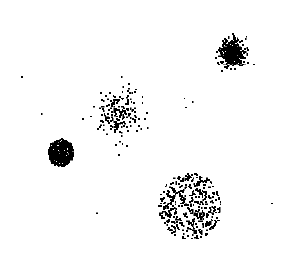
Outliers
Outliers are data objects with characteristics that are considerably different than most of the other data objects in the data set
Case 1: Outliers are noise that interferes with data analysis
Case 2: Outliers are the goal of our analysis
Credit card fraud
Intrusion detection
Causes?

Slide 66
Outliers
Outliers : values of an attribute that are unusual with respect to typical values for that attribute
Anomalous objects
Noise and outliers are different
How? Outliers are legitimate data objects or values

Slide 67
Missing values
Usual for an object to have one or more attribute values missing

Slide 68
Missing Values
Reasons for missing values
Information is not collected (e.g., people decline to give their age and weight)
Attributes may not be applicable to all cases (e.g., annual income is not applicable to children)
Handling missing values
Eliminate data objects or variables
Estimate missing values
Example: time series of temperature
Example: census results
Ignore the missing value during analysis

Slide 69
Eliminate data objects or Attributes
Simple approach: to eliminate objects with missing values
Partially specified data object contain some information
Reliable data analysis cannot be carried with many missing objects
In a data set if few objects are missing : omit them
Eliminate attributes that have missing values
Sometimes they are critical for analysis

Slide 70
Estimate missing values
Missing data can be estimated
Example: time series data
Consider attribute values of the points closest to the point with the missing value are often used to estimate
Continuous: average attribute value of the nearest neighbor is used to estimate missing value
Categorical: most commonly occurring attribute value can be taken

Slide 71
Ignore the missing value during analysis
Modify data mining approaches to ignore missing values
Clustering: similarity between pairs of data objects
Data objects can have missing values, consider only those attributes that do not have missing values (just an approximation if one or two pairs are missing)
Classification : modify to deal with missing values

Slide 72
Inconsistent values
Data: inconsistent values
Example: Address field (both zip code and city ) specified zip code area is not contained in the city.
Detect and correct them
Examples: person’s height should not be negative, insurance company during reimbursement checks names and addresses in the claim forms and customers database, product code may have ‘check’ digits (against a list of products)
correction of inconsistency requires additional data

Slide 73
Duplicate Data
Data set may include data objects that are duplicates, or almost duplicates of one another
Major issue when merging data from heterogeneous sources
Examples:
Same person with multiple email addresses
Data cleaning
Process of dealing with duplicate data issues
Deduplication: is a process that deals with similar data objects

